Slide 1
ICSE
PROJECT
ON
HOTEL
RESERVATION SYSTEM
COMPILED BY:
Manish Kumar Singh
CLASS-X
ROLL NO.-20
YEAR-(2018-19)

Slide 2
CERTIFICATE
This wonderful project has been submitted by Manish Kumar Singh of class X under the supervision of Miss Savitri Limboo.It took approximately 10 days for me to complete this project.

Slide 3
Welcome to
Hotel
TAJ!!
MUMBAI

Slide 4
Project
Objectives: This project is made to make it easy to reserve a hotel room. We can book any kind of room in this online hotel reservation system.
Project category: This project is based on the java language. Java handling is the back end. The program is object oriented.
Tool/platform language: Windows 8 is used This operating system is easily available and is versatile with many features such as multimedia, graphics, and etc. The language adapted for development of this project is JDK 4.1.2. It works nicely on the platform of windows 8 or higher version.
Structure of the program:There are many rooms that can be booked as per our wish in this program and the main method which defines the many functions of program.

Slide 5
Data type variable used
Boolean | Type[],breakfast
Int | Adults,Child,no, days room
String | Date,name,occp,add pur,rname
Double | Bills
Details
Int:it is small amount of integer value.
String: it is the sequence of characters enclosed in double quotes
Boolean: it results in true or false.
Double: it stores large fractional numbers.

Slide 6
Functions
void input( ):To input all the details of the hotel including its location and also the confirmation for the booking of the room is done here.
void roombook( ):Rooms of different kind are displayed here.We can select any type of room we want. Either it be a ac deluxe, non ac deluxe ,queen suite or king suite. We can choose any one.
void registration( ):Registration for the booking of room in hotel red star is done in this function. Registration includes your personal details including your name, date of booking , gender, occupation etc.
void billcalc( ):This method is used to calculate the bill(amount which we need to pay to the manager of the hotel for the reservation of the room).

Slide 7
System development
System development is a process consisting of two major steps such as analysis and design, starts when the system development person realize that a particular system needs development. it goes through the development cycle.
System Development of Life Cycle :
The system development life cycle method is classically thought of as the activities that analysis designers and users carry out to develop and implement an information system. This comprises of the following activities

Slide 8
Outline
This project is mainly based on hotel rooms reservation through very easy and affordable manner.it allows us to book the rooms as per our convenience. This project helps us in room booking its registration and process of the pament.it uses 4 different methods each for different purpose. And also contains one class.
This project is and easy and a convenient way of booking the rooms in an hotel.

Slide 9
Important Use
Library files : java.util
Method used : public
println : to move the cursor to the next line.
print : to let the cursor remain on the same line.
equalsIgnoreCase : ignores all the cases i.e., upper case and the lower cases and stores the value.

Slide 10
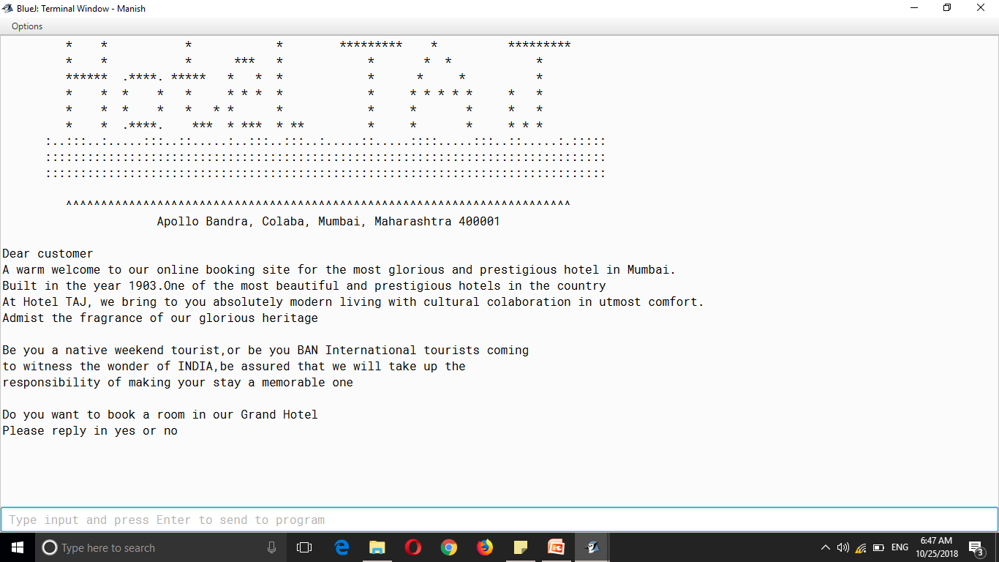
Input screen

Slide 11
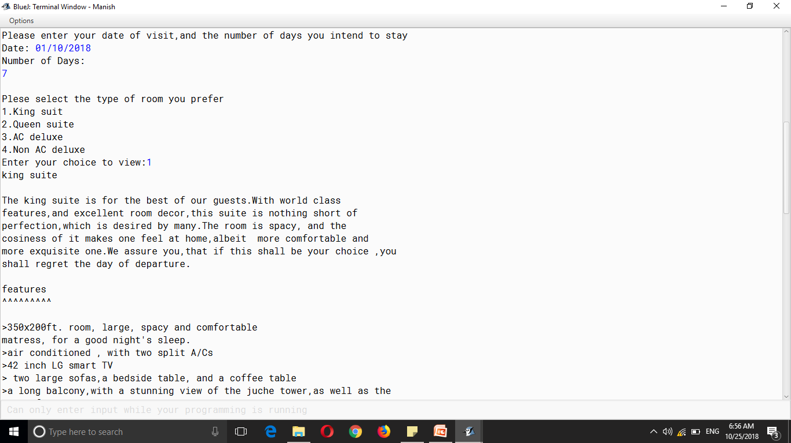
Output screen

Slide 12
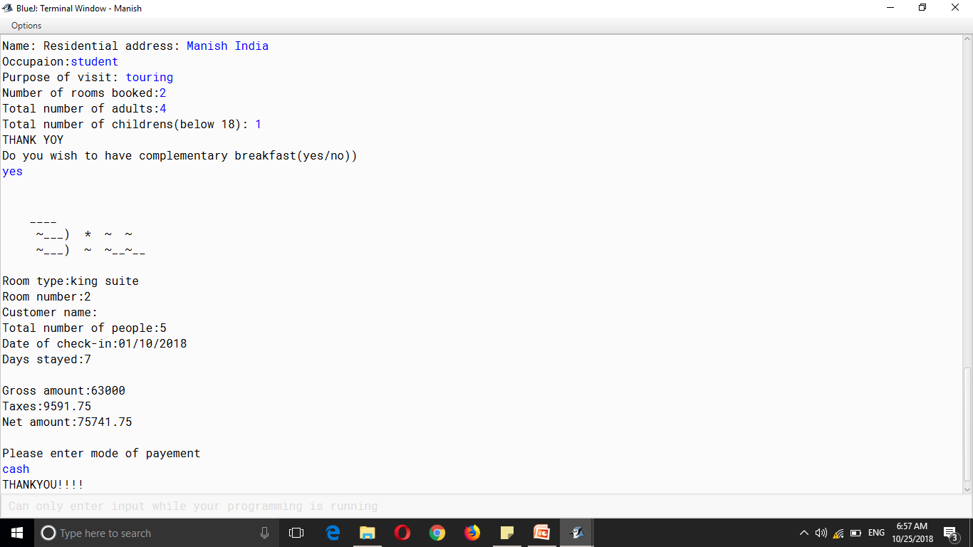
Output 2

Slide 13
Thank you!! for watching
Thank you

